Slide 1


Computational and analytical chemistry of the environment EMOS Group
EXPLORING THE ROLE OF POLYMERS IN WATER PURIFICATION: EXPERIMENTS, MODELING, AND MACHINE LEARNING
Dr. Sanja Armaković
Contemporary Materials 2024 - Savremeni Materijali
September 5 - 6, 2024.

Slide 2

The problem of ORGANIC pollutants in water
The aqueous environment is crucial to the water cycle, world ecology, and various human activities.
Water pollution, including chemicals like pharmaceuticals, pesticides, plastics, and dyes, poses serious environmental problems.

Slide 3
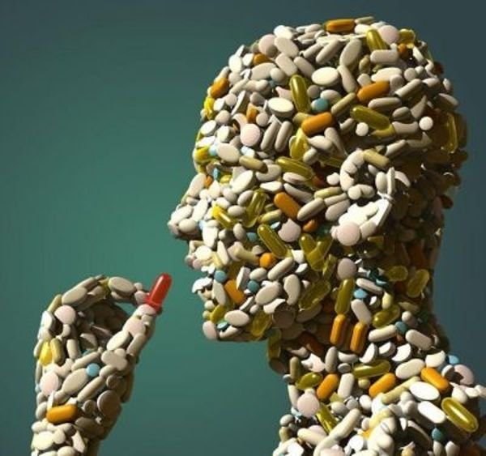
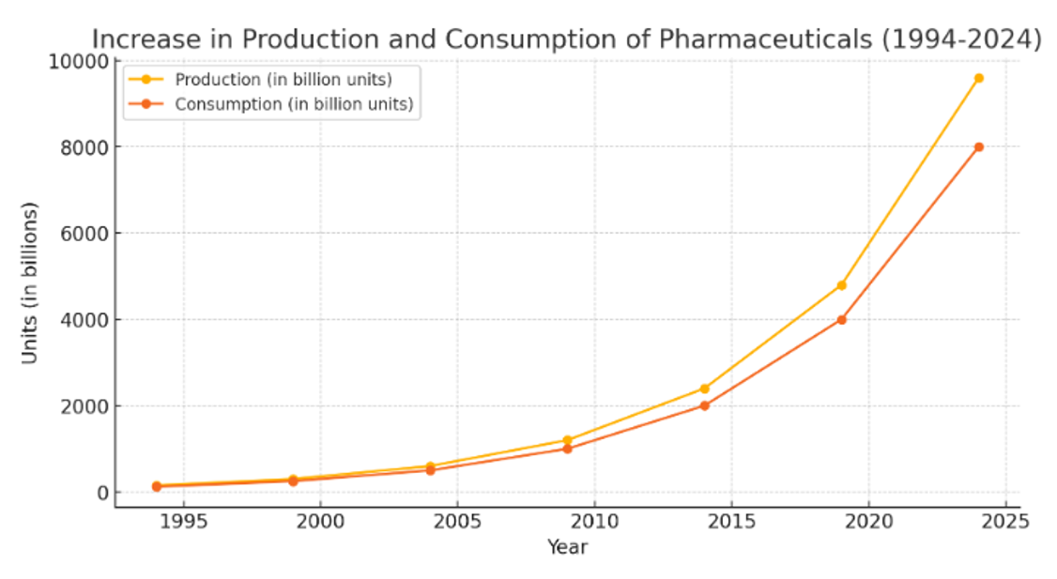
The production and consumption of pharmaceuticals have increased dramatically in recent decades
This increase is driven by various factors, including advancements in medical science, an aging population, and greater access to healthcare.
Consequently, this has led to a rise in pharmaceutical pollutants in the environment, presenting new challenges for waste management and environmental protect.

Slide 4
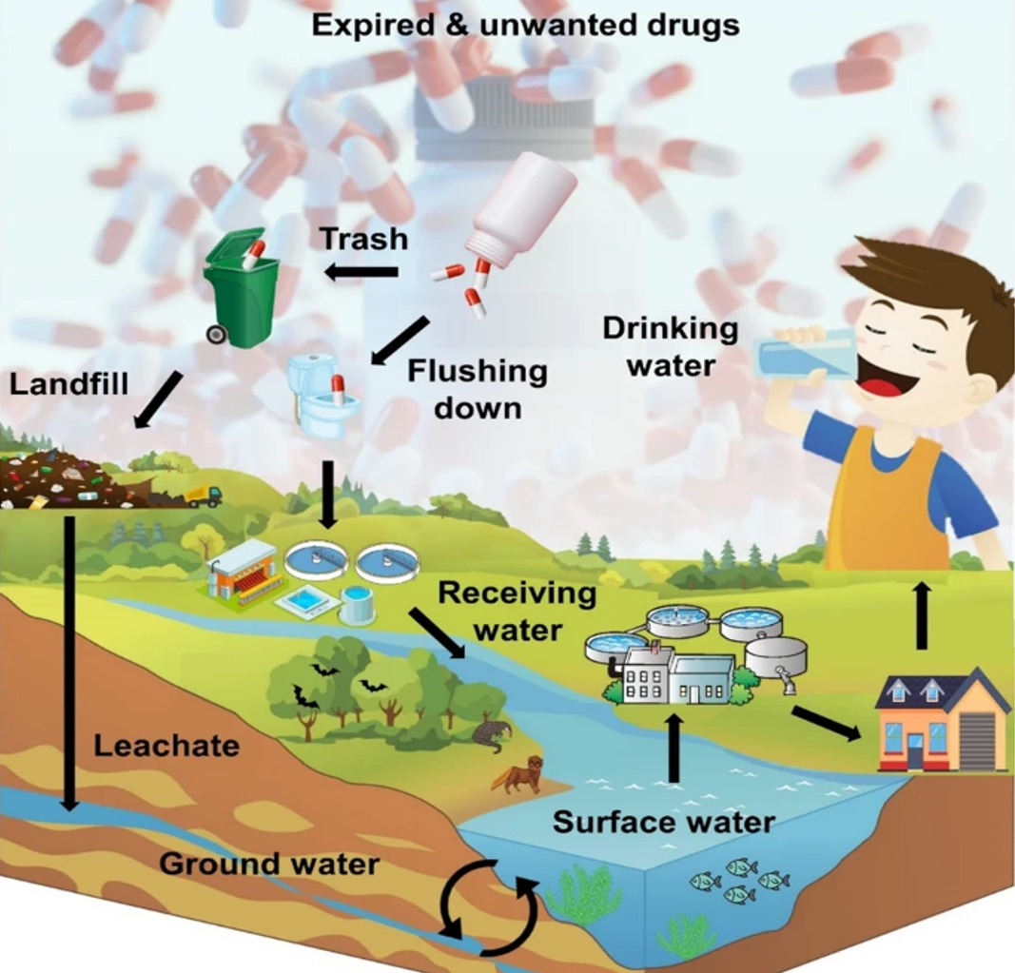
Pharmaceuticals enter the environment through various pathways, such as:
disposal of down drains,
excretion,
manufacturing waste.
These compounds pose risks to ecosystems and human health.
Notes:
Pharmaceuticals enter the environment through various pathways. One common route is through the disposal of unused or expired medications down the drain or toilet, which eventually end up in wastewater treatment plants. These facilities may not completely remove pharmaceutical compounds, leading to their release into water bodies. Another pathway is through excretion. When humans or animals consume pharmaceuticals, their bodies metabolize some of the compounds, but a portion is excreted unchanged in urine or feces. These residues can enter the environment through sewage systems or runoff from fields where animal waste is spread as fertilizer. Additionally, pharmaceutical manufacturing facilities may release compounds into the environment through wastewater discharge or improper disposal of production waste. Overall, the complex network of pharmaceutical usage, disposal, and manufacturing contributes to the widespread presence of these compounds in the environment.
Farmaceutski proizvodi ulaze u životnu sredinu različitim putevima. Jedan uobičajeni put je odlaganje neiskorišćenih lekova ili lekova kojima je istekao rok u odvodu ili toaletu, koji na kraju završe u postrojenjima za prečišćavanje otpadnih voda. Ovi objekti možda neće u potpunosti ukloniti farmaceutska jedinjenja, što dovodi do njihovog oslobađanja u vodena tela. Drugi put je kroz izlučivanje. Kada ljudi ili životinje konzumiraju farmaceutske proizvode, njihova tela metabolišu neka od jedinjenja, ali se deo izlučuje nepromenjen urinom ili izmetom. Ovi ostaci mogu ući u životnu sredinu kroz kanalizacione sisteme ili oticati sa polja gde se životinjski otpad rasipa kao đubrivo. Pored toga, farmaceutski proizvodni pogoni mogu ispuštati jedinjenja u životnu sredinu ispuštanjem otpadnih voda ili nepravilnim odlaganjem proizvodnog otpada. Sve u svemu, složena mreža farmaceutske upotrebe, odlaganja i proizvodnje doprinosi širokom prisustvu ovih jedinjenja u životnoj sredini.

Slide 5

From an economic perspective, the costs associated with eliminating organic pollutants in water treatment plants are significant due to the need to improve treatment technologies.
Today, the most common technologies for removing organic pollutants include reverse osmosis, ultrafiltration, nanofiltration, activated carbon, and many others.
However, these processes do not entirely remove all organic pollutants (including pharmaceuticals) from the water. The inefficiency of conventional methods in wastewater treatment and the removal of pharmaceutical compounds from wastewater have become global problems.
Various advanced oxidation processes (AOPs), particularly those utilizing sustainable polymers, have emerged as promising methods.
Photocatalytic degradation using polymer-based materials offers the potential for efficiently removing organic pollutants from the environment with:
minimal energy consumption,
low operational costs, and, importantly,
without generating toxic by-products that could cause further contamination.
Notes:
Iz ekonomske perspektive, troškovi povezani sa eliminacijom organskih zagadjujucih ostataka u postrojenjima za prečišćavanje vode su značajni zbog potrebe za naprednim tehnologijama tretmana.
Farmaceutski proizvodi često ostaju kao tragovi u izvorima vode, što povećava troškove njihovog uklanjanja. Da bismo zadovoljili trenutne zahteve bez štete po životnu sredinu, ključno je osmisliti održivo, dugotrajno rešenje za uklanjanje farmaceutskih proizvoda, uzimajući u obzir društvene, tehničke, ekonomske i ekološke faktore.

Slide 6

To prevent pharmaceuticals from entering the environment, the following measures can be implemented:
Proper Disposal Programs ‒ establish and promote take-back programs and designated disposal sites for unused or expired medications to prevent them from being flushed down the drain.
Public Education ‒ educate the public on the environmental impacts of improper pharmaceutical disposal and the importance of using designated disposal methods.
Regulation and Monitoring ‒ Implement stricter regulations on pharmaceutical manufacturing processes to ensure that waste products are properly managed and treated before being released into the environment.
Development of Green Pharmaceuticals ‒ Encourage the development and use of pharmaceuticals that are less persistent and more biodegradable in the environment.
Improved Medical Practices ‒ Promote the rational use of medications to reduce overprescription and unnecessary pharmaceutical waste.
Advanced Wastewater Treatment ‒ upgrade wastewater treatment facilities to include advanced filtration and chemical treatment processes that can effectively remove pharmaceutical compounds.

Slide 7
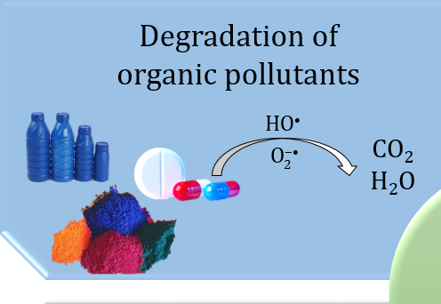
The application of nanotechnologies, such as TiO₂, ZnO, etc., for removing pollution from water is widely used.
However, nowadays, new polymer materials and their modifications are used very often alongside TiO₂ and ZnO.
Manufacturing processes and techniques for novel polymer foams are constantly improving.
Due to their unique properties and performance, polymer foams have achieved significant improvements in product performance, cost-effectiveness, weight reduction, etc.
Polymer
materials
Due to their distinctive chemical and physical properties, polymeric materials are considered suitable and promising candidates for AOPs.

Slide 8
The fundamental classification of polymers
Inorganic polymers
Organic polymers
a porous framework that is impregnated in various dimensions
crystalline and amorphous depending on the difference in the arrangement of monomers in their structure
Inorganic-organic hybrids
flammable, durable, resistant to rust, and non-poisonous
widely employed in water purification treatment due to their large surface area, electrical conductivity, stability, flexibility, and reusability
mainly used as photocatalysts for modifications because of their extraordinary stability, inherent porosity, economical designs, and flexibility in structure and function
mechanical, thermal, and physical properties are enhanced to a high extent
inorganic constituents provide stability to heat and friction and enhance chemical and electromagnetic properties and refractive index, while the organic components are responsible for producing films

Slide 9
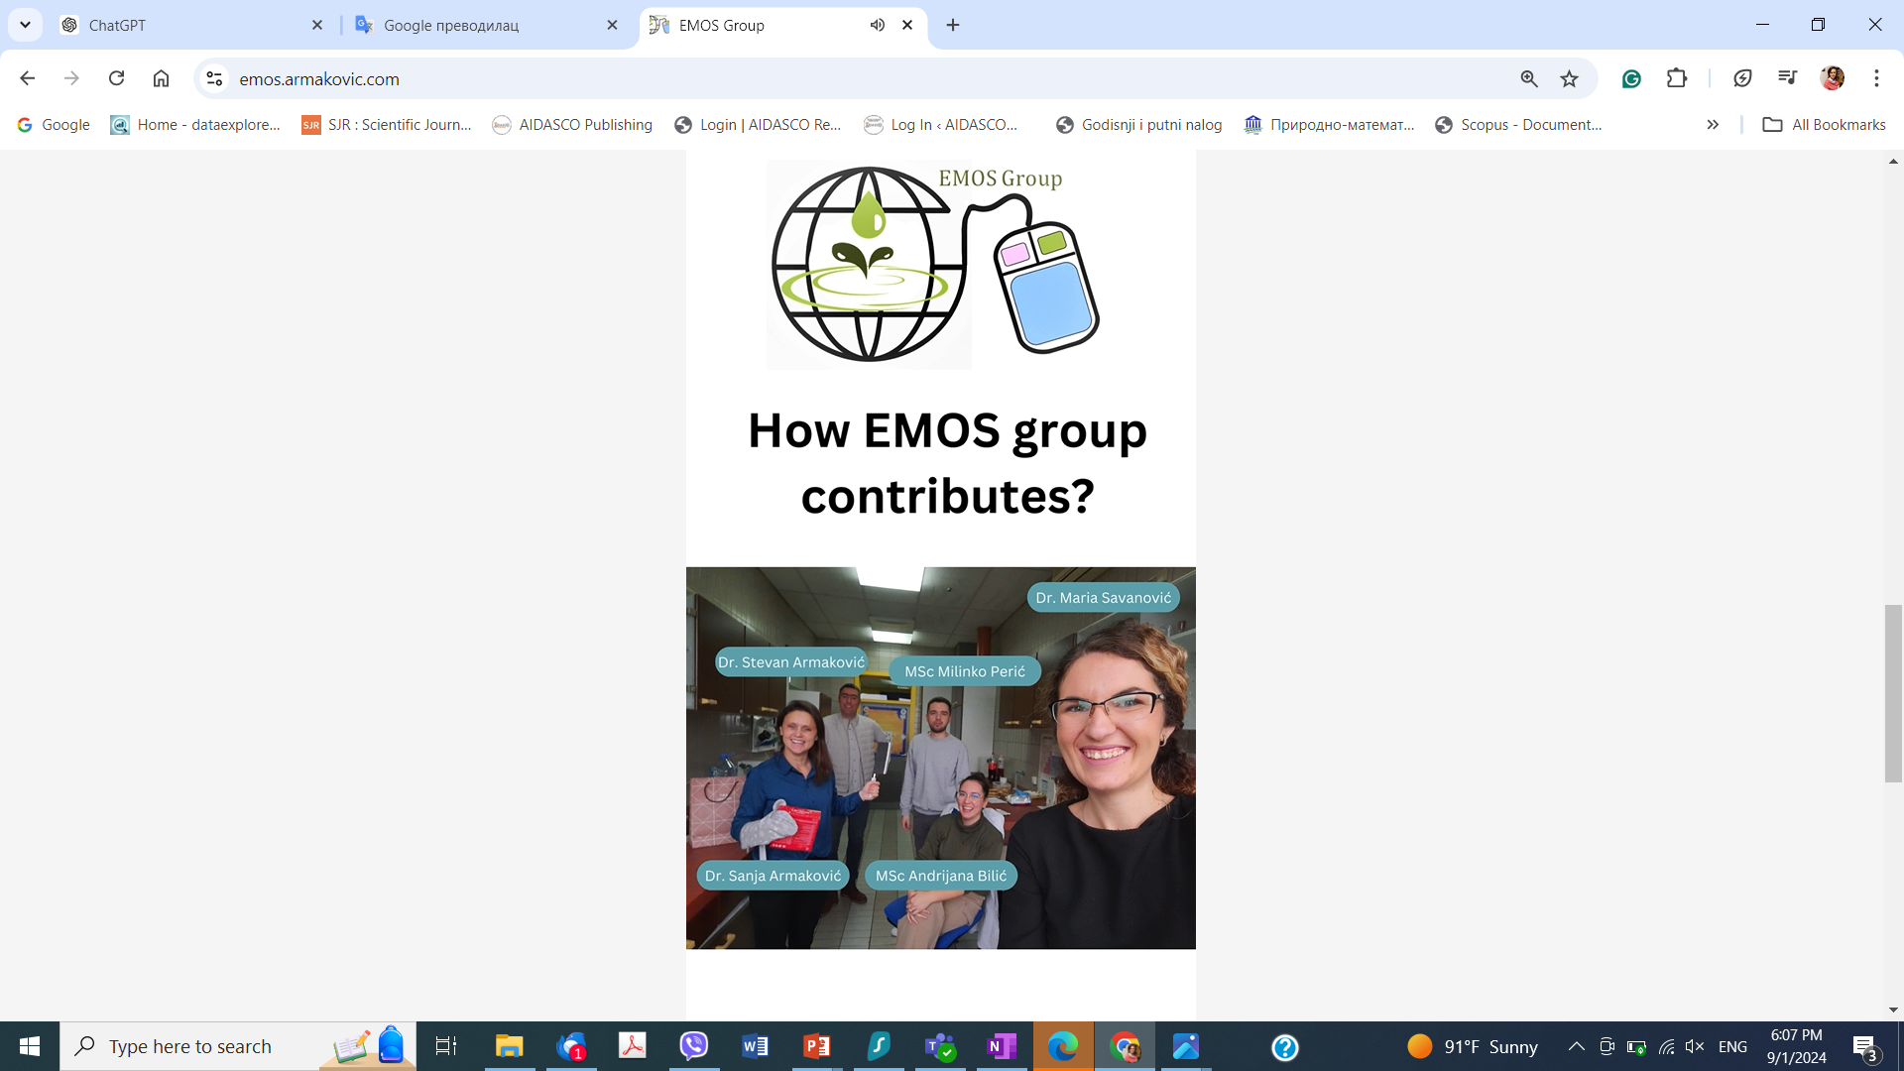

Slide 10

Physical modification techniques
Mechanical blending
Extrusion processing
Chemical modification techniques
Nanocomposite formation
Plasma modification
Surface functionalization
Cross-linking
Modification of polymers for enhanced photocatalytic activity
PMMA
Cu-TiO₂ PMMA
Cu-TiO₂ immobilized on
poly(methyl methacrylate) (PMMA)

Slide 11
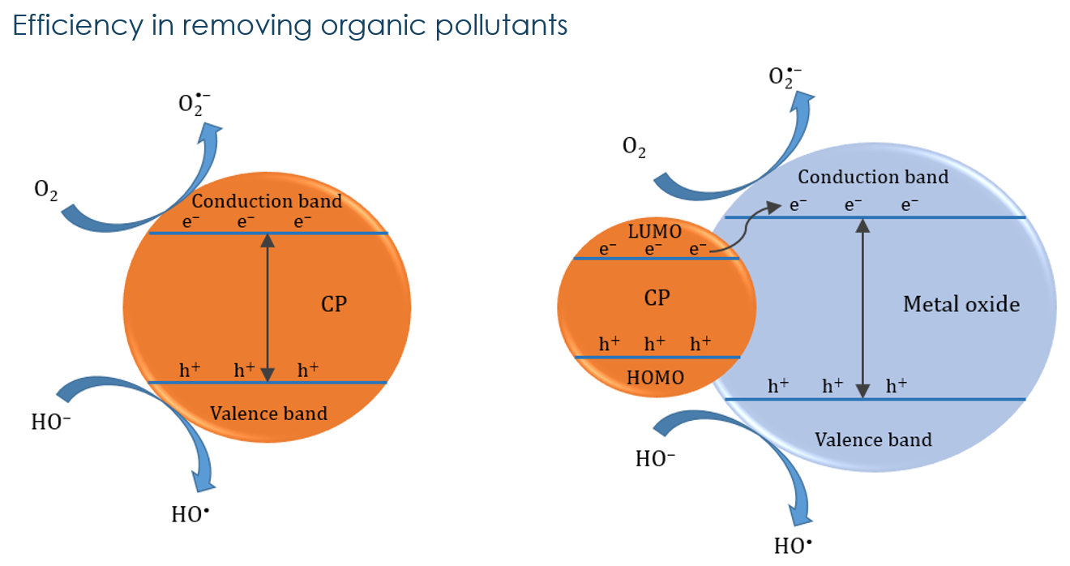
The advantage of using polymers as sensitizing agents in photocatalytic composites is that they could contribute to improving the photocatalytic efficiency due to π-conjugated systems containing high concentrations of electron-rich species, which are available for transfer in the semiconductors conduction band.
The scheme of photocatalysis, based on (a) conducting polymer (CP) nanocomposite and (b) conducting polymer–metal oxide hybrid modification
It is proved that by using polymer materials, the recombination of the photo-generated charge carriers is reduced, while the conductive polymers tune the semiconductor’s band gap.

Slide 12
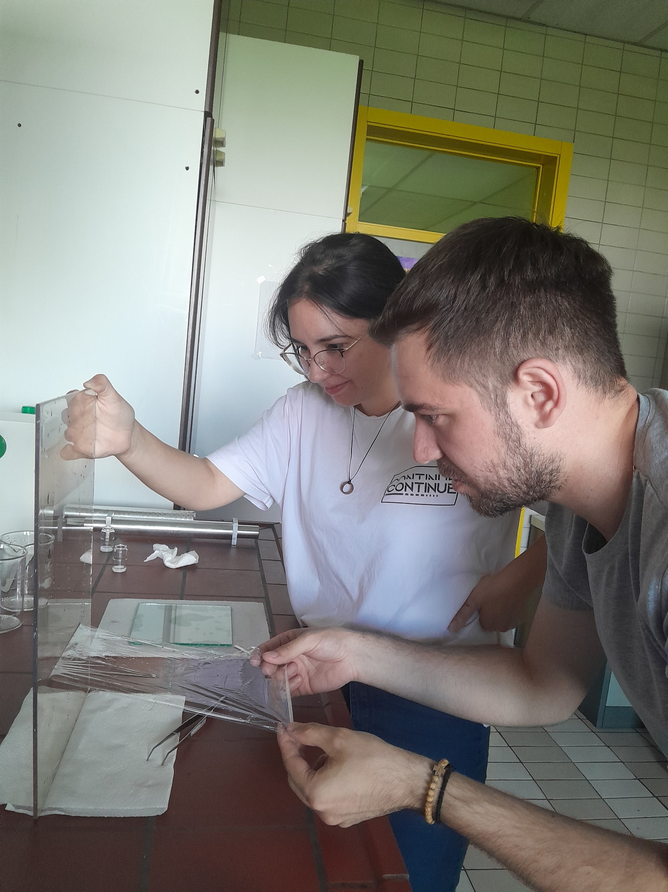
Polymer membranes are generally synthesized from organic solvent mixtures involving polymers and additives and need to be prepared in films.
According to their applications, the polymer type/dosage, the polymer concentration, the crosslinking density, the film thickness, and the additives could be chosen to achieve the aim, including materials like polysulfone, polyetherimide, cellulose acetate, poly(vinylidene fluoride), and others.
It could be preferred to utilize polymer membranes owing to their exceptional properties such as structure, surface modifications/enhancements, and hydrophobic/hydrophilic balance, size, function, and cost for specific applications
MSc Andrijana Bilić and MSc Milinko Perić during the process of synthesis of PMMA, a synthetic polymer derived from methyl methacrylate, which is commonly used as an engineering plastic.
Known for its transparency, PMMA is a thermoplastic that goes by several names, including acrylic, acrylic glass, and the trade names Crylux, Hesalite, Plexiglas, Acrylite, Lucite, and Perspex.

Slide 13
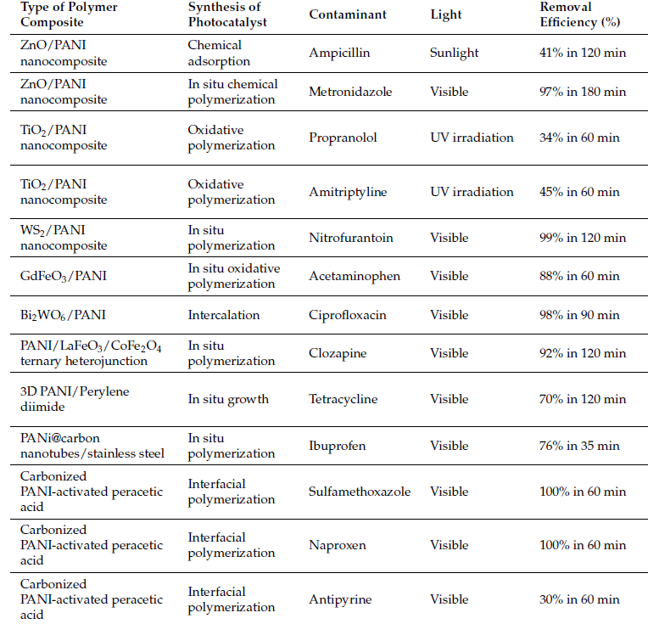
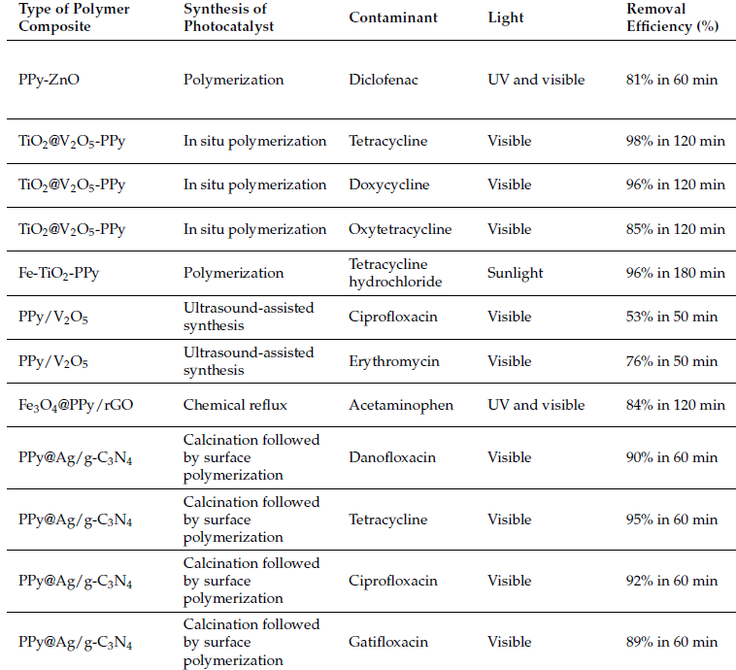
Researchers are becoming more interested in developing new polymeric materials that have a high affinity for harmful organic compounds and exhibit high fluxes in membrane separation processes for the treatment of natural water, underground, and domestic and industrial sewage.
Polymers such as
poly-aniline,
poly(p-phenylene vinylene),
polyethylene oxide,
polypyrrole,
polythiophene,
poly(1-naphthylamine),
polycarbazole,
polyacetylene,
poly(3,4-ethylenedioxythiophene), and
poly(o-phenylenediamine)
exhibit visible ab-sorption activity due to their low band gap values, which make them ideal candidates for extending the semiconductors range of light absorption.

Slide 14

Advantages and challenges

Slide 15
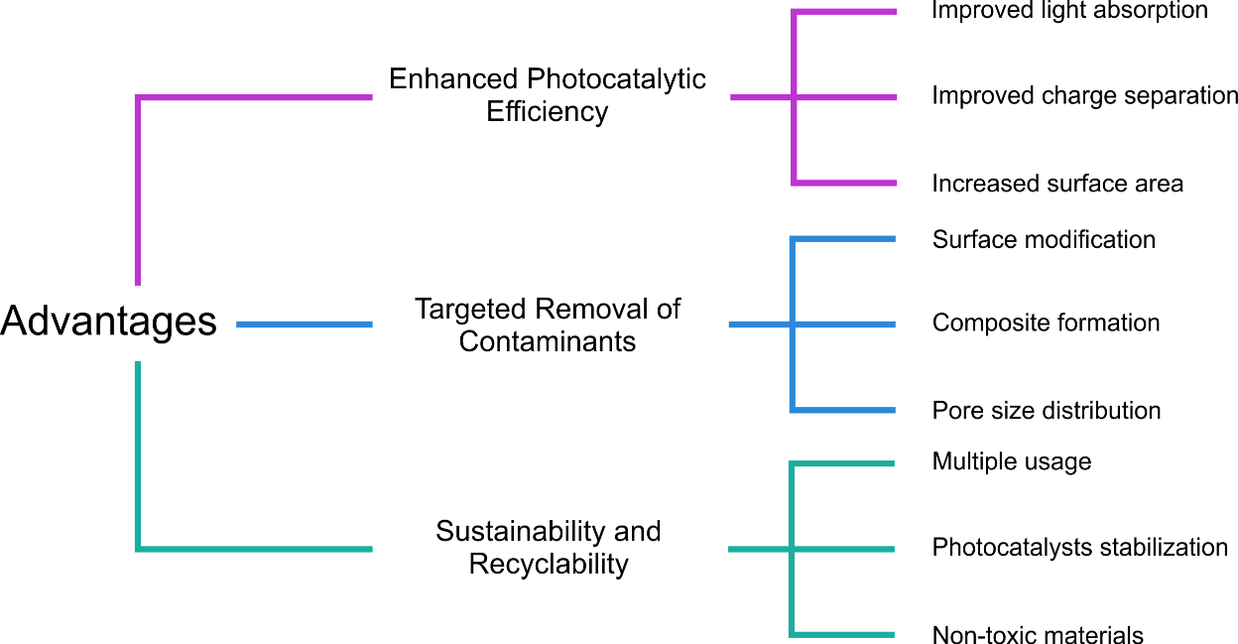

Slide 16

Current challenges include
polymer stability
Polymers can undergo photo-degradation when exposed to UV or visible light, leading to the breakdown of polymer chains and loss of mechanical and chemical properties
costs
€
Synthesis
potential toxicity of degradation products
!
Compounds formed after the degradation of the organic pollutant can be more dangerous and toxic than the parent compounds
☼
The stability of polymers in water is essential for their use in environmental applications
Modification
Characterization of materials

Slide 17


Atomistic calculations in polymer materials science

Slide 18
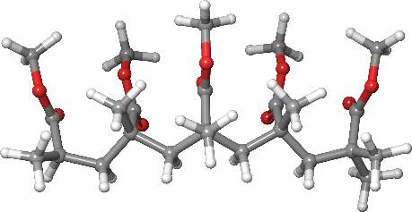
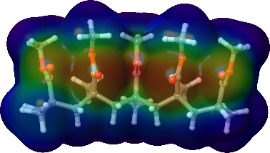
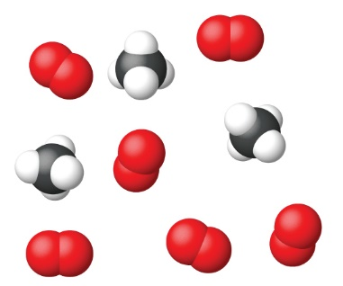
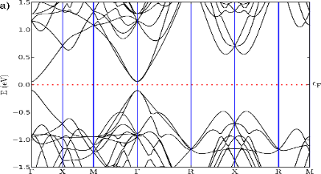
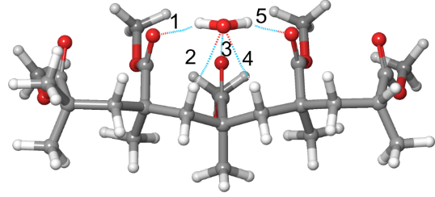
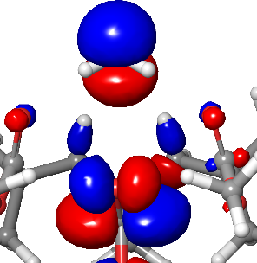
The role of atomistic calculations in polymer materials science
Due to the great diversity of polymers and their potential for modification, it is necessary to apply different methods to select the most suitable candidates for synthesis and further functionalization
Atomistic calculations are computational methods that model the behavior of systems at the atomic and molecular levels
Enable prediction of various molecular properties such as structure, global and local reactivity
Structural
properties
Application of atomistic calculations
Charge
distribution
Reactions
Band
structure
Adsorption
Stability
Notes:
Zbog velike raznolikosti polimera i njihovog potencijala za modifikaciju, neophodno je primeniti različite metode za odabir najpogodnijih kandidata za sintezu i dalju funkcionalizaciju.
Jedan od ključnih pristupa koji omogućava predviđanje svojstava polimera koji još nisu sintetisani jeste primena atomističkih proračuna.
Atomistički proračuni obuhvataju kompjuterske metode koje omogućavaju simulaciju ponašanja sistema na nivou atoma i molekula, pružajući uvid u strukturu, dinamiku i reaktivnost materijala na fundamentalnom nivou. Njihova primena u istraživačkim grupama je od neprocenjive vrednosti, jer omogućavaju teorijska istraživanja koja se mogu primeniti u gotovo svim aspektima nauke o materijalima.
Neki od najpoznatijih primera atomističkih proračuna uključuju:
- Proračune zasnovane na teoriji funkcionala gustine (eng. Density Functional Theory - DFT), koji omogućavaju predikciju elektronske strukture materijala;
Simulacije molekulske dinamike (MD) zasnovane na međumolekularnim potencijalima, koje omogućavaju razumevanje kretanja i interakcija molekula kroz vreme.
Ovi proračuni predstavljaju osnovu za razvoj novih materijala, optimizaciju postojećih i razumevanje kompleksnih fenomena u materijalima i kao takvi redovno se primenjuju u razvoju polimernih materijala

Slide 19
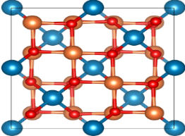
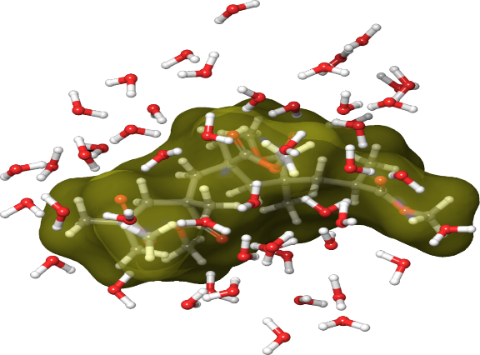
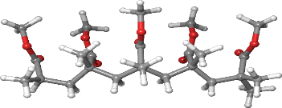
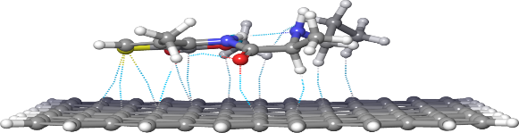
All methods of atomistic calculations can be divided into three large groups, depending on the theoretical approach underlying the calculation of the total energy of the molecular system
Atomistic calculations
Quantum mechanics
Classical (molecular) mechanics
Wavefunction based
Electron density based
MD
force field methods
Coarse grained methods
Semiempiric
Hybrid methods
QM/MM
QM/SE
SE/MM
HF, MP2, ADC, CCSD,
DFT with numerous functionals
Wavefunction based
Electron density based
AM family
PM family
DFTB
xTB
AMBER, CHARMM, OPLS, etc
Molecular & periodic DFT
MD simulations
Notes:
Razvijanje i primena atomističkih proračuna predstavljaju izuzetno složenu i uzbudljivu oblast istraživanja. Tokom vremena razvijen je ogroman broj teorijskih metoda koje omogućavaju predviđanje svojstava molekulskih ili periodičnih struktura. Iako je gotovo nemoguće nabrojati sve ove metode, korisno je napraviti najopštiju podelu atomističkih proračuna.
Sve metode atomističkih proračuna mogu se podeliti u tri velike grupe, u zavisnosti od teorijskog pristupa koji je u osnovi proračuna ukupne energije molekulskog sistema:
kvantno-mehaničke metode,
klasične metode (molekulska mehanika) i
hibridne metode koje kombinuju oba pristupa.
Kvantno-mehanički metodi: Metodi kod kojih je molekul kvantno-mehanički objekat, što iziskuje primenu kvantne mehanike. Dakle, koristi se kvantno mehanički pristup za određivanje ukupne energije molekula
Metodi zasnovani na talasnoj funkciji: Ovi metodi uključuju rešavanje Šredingerove jednačine kako bi se dobila optimalna talasna funkcija sistema. Talasna funkcija pruža kompletan opis kvantnog stanja sistema, a proračuni koji koriste ovu metodu omogućavaju veoma precizne predikcije.
Metodi zasnovani na elektronskoj gustini: Ovi proračuni, kao što su oni zasnovani na teoriji funkcionala gustine (DFT), fokusiraju se na rešavanje Kon-Šamovih jednačina kako bi se dobila optimalna elektronska gustina sistema. Optimalna gustina je ona koja minimizuje ukupnu energiju sistema, pružajući uvid u raspodelu elektrona u prostoru.
Klasična (molekulska) mehanika: Metod kod kojeg se molekul posmatra kao klasičan objekat, atomi su loptice, a veze među njima se posmatraju kao opruge. Izraz za određivanje energije (potencijal polja) je u tom slučaju jednostavan klasičan matematički izraz.
Ovi metodi se oslanjaju na potencijalne energije između atoma ili molekula, koje se često modeliraju jednostavnim matematičkim funkcijama. Klasična mehanika ne uzima u obzir kvantne efekte, ali može biti veoma korisna za simulacije velikih sistema ili dugih vremenskih skala, gde kvantno-mehanički proračuni postaju nepraktični.
Hibridne metode:
Kombinujući kvantno-mehaničke i klasične metode, hibridne metode, kao što je QM/MM (Quantum Mechanics/Molecular Mechanics), omogućavaju modeliranje velikih sistema sa visokom preciznošću u regionima od posebnog interesa (kvantno-mehanički opis), dok ostatak sistema koristi manje računski zahtevnu klasičnu mehaniku. Ove metode su posebno korisne za proučavanje hemijskih reakcija u složenim okruženjima, poput enzima ili materijala sa heterogenim strukturama.
Ova podela pruža okvir za razumevanje širokog spektra teorijskih metoda koji su dostupni za istraživanje materijala i molekula, i naglašava važnost odabira odgovarajućeg pristupa u zavisnosti od prirode sistema i pitanja koje se istražuje.
Što se tiče polimera, svi navedeni metodi se redovno primenjuju u istraživanju polimera, sa naznakom da se zbog dimenzija polimernih sistema nešto češće primenjuju simulacije molekulske dinamike. Između ostalih svojstava, primenom MD simulacija u slučaju polimera moguće je ispitivati:
Uticaj temperature na strukturna i generalno dinamička svojstva polimera
Temperaturu prelaza u staklasto stanje (Glass transition temperature) – veličina specifična za polimere
Uticaj rastvarača itd

Slide 20
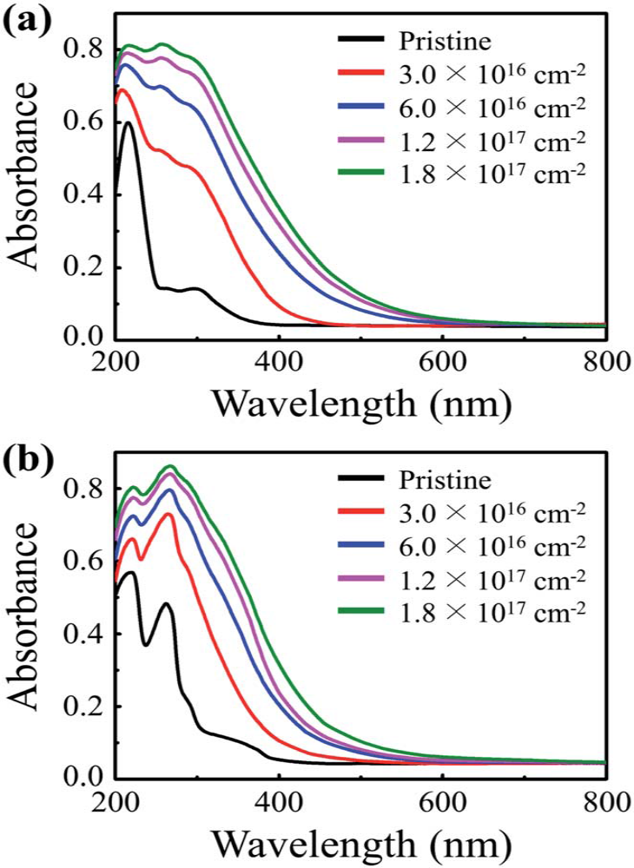
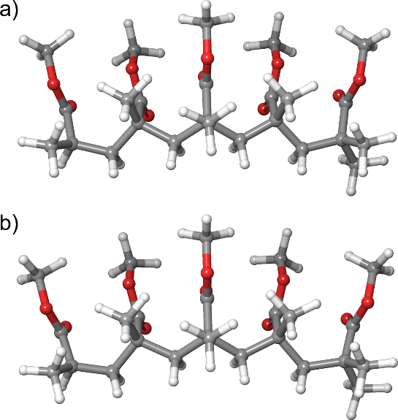
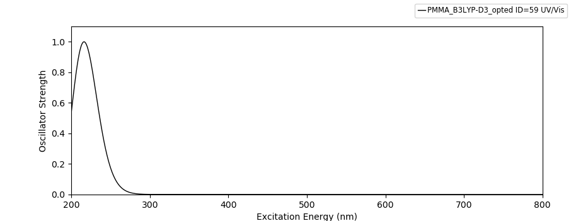
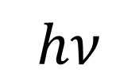
Light absorption is certainly one of the fundamental processes in photocatalytic processes
$$hν$$
Lee et al, RSC Adv., 2020, 10, 356–361
PMMA optimized via B3LYP-D3/6-31G(d,p)
and UV spectrum simulated at TD-DFT/CAM-B3LYP/6-311++G(d,p)
Notes:
Apsorpcija svetlosti je svakako jedan od fundamentalnih procesa kod fotokatalitičkih procesa (ovde se može malo po potrebi još začiniti priča)
Moć atomističkih proračuna leži upravo u sledećim činjenicama:
Primenom odgovarajućih nivoa teorije moguće je proceniti u kojoj meri neki molekul apsorbuje svetlost u poređenju sa nekim drugim molekulom
Kako različite modifikacije nekog molekula ili materijala/fotokatalizatora utiču na apsorpciona svojstva. Konkretno, primenom vremenski zavisnog DFT pristupa (TD-DFT)
Kako prisustvo nekog drugog molekula u blizini fotokatalizatora (tj. kako adsorpcija/interakcija nekog molekula sa polimerom) utiče na apsorpciona svojstva prema svetlosti
Moguće je utvrditi čak i koji deo molekula (koji fragment molekula) je primarno odgovoran za apsorpciju svetlosti.
Sve ove činjenice omogućavaju dizajniranje molekula/polimera/fotokatalizatora sa fino podešenim fizičko-hemijskim svojstvima neophodnih za efikasne napredne oksidacione procese.
Iako je TD-DFT metod najčešće korišćen metod za ispitivanje ekscitacija, a time i simuliranje UV spektra, nije i najtačniji. Međutim, uz pažljivi odabir funkcionala (npr. CAM-B3LYP ili ωB97X-D) moguće je relativno „jeftino“ simulirati UV spektar organskih sturktura sa značajnom preciznošću.
Za preciznije simuliranje UV spektra, neophodno je koristiti neki od metoda zasnovnaih na talasnoj funkciji, međutim, ti metodi su karakterisani značajno većim kompjuterskim vremenom neophodnim za sprovođenje proračuna.
U konkretnom primeru smo simulirali UV spektar PMMA lanca i uporedili sa eksperimentalnim rezultatima. Prilično priuštiv nivo toerije na bazi CAM-B3LYP funkcionala daje odlično slaganje sa eksperimentalnim rezultatima.

Slide 21

The power of computational calculations is best illustrated by the fact that the first step in the development of novel materials or the improvement of current ones often involves the application of computational methods to predict the properties of structures before they are synthesized.
This approach allows researchers to identify the best candidates for physical experimentation, thereby optimizing research and minimizing resource use.
MODELING TOOLS
Open source
Commercial
- xtb
- MOPAC
- LAMMPS
- GROMACS
- PSI4
- NWCHEM
- Multiwfn
Commercial & free for academics
- Schrödinger Inc
- Gaussian
- SCM ADF
- Materials Studio
- VASP
- ORCA6
- Pymol
By using these computational tools, scientists can efficiently screen a wide range of materials and focus on those with the most promising properties, significantly reducing the time and cost associated with experimental trials.
Notes:
Uporedo sa razvojem metoda za modelovanje, razvijen je i ogroman broj kompjuterskih kodova i programa koji se koriste za simulacije i modeliranje. Iako je teško nabrojati sve dostupne alate, korisno je napraviti podelu sa aspekta dostupnosti:
Alati otvorenog koda,
Komercijalni alati i
Komercijalni alati koji su besplatni za akademsku upotrebu
Alati otvorenog koda:
Alati otvorenog koda, kao što su GROMACS ili LAMMPS, slobodno su dostupni, a njihov izvorni kod je otvoren za modifikacije. To omogućava korisnicima da prilagode softver specifičnim potrebama istraživanja.
Prednosti: Besplatni su za korišćenje, omogućavaju prilagođavanje i često imaju aktivne zajednice koje pružaju podršku.
Mane: Mogu biti manje intuitivni za korišćenje, sa ograničenom zvaničnom podrškom, a ponekad zahtevaju više tehničkog znanja za instalaciju i konfiguraciju.
Komercijalni alati:
Komercijalni alati, kao što su Gaussian ili Materials Studio, često dolaze sa intuitivnim korisničkim interfejsom i robusnom tehničkom podrškom. Ovi programi obično nude sveobuhvatna rešenja za modeliranje i simulaciju.
Prednosti: Visok nivo podrške, redovno ažuriranje softvera, široka paleta funkcionalnosti i često jednostavna integracija sa drugim alatima.
Mane: Visoki troškovi licenci, što može biti prepreka za manja istraživačka udruženja ili individualne korisnike.
Komercijalni alati, ali besplatni za akademsku upotrebu:
Neki komercijalni alati, poput ORCA, nude besplatne licence za akademske istraživače, što omogućava pristup sofisticiranim alatima bez visokih troškova.
Prednosti: Pristup naprednim funkcijama bez troškova, idealno za akademske grupe koje ne mogu priuštiti skupe licence.
Mane: Iako su besplatni, mogu postojati ograničenja u korišćenju ili podršci, a ponekad su verzije za akademsku upotrebu manje bogate funkcijama u poređenju sa punim komercijalnim verzijama.
Kada se radi o polimerima, u naučnoj literaturi postoje informacije o primeni praktično svih navedenih alata za modelovanje.

Slide 22


Development of tools within EMOS research group
Online molecular modeling platform
Online input generators for modeling codes (ORCA, PSI4)
Online semiempiric calculations with xtb and MOPAC
Online generator of MD systems
Online automation of tasks with Multiwfn
Desktop GUIs for ORCA and xtb
https://atomistica.online
Join Discord server: https://discord.gg/cDcTT6NknH
Online platform for statistical analysis
Online statistical analysis platform
Standard statistical tests
Data pre-analysis and preparation tools
Correlation analysis
Cluster analysis
https://dataexplorer.online
Notes:
O atomistici i dataexploreru, sa aspekta EMOS grupe.
U okvirima EMOS grupe, razvijena je besplatna online platforma za molekulsko modelovanje koja sadrži:
Online grafičke interfejse za pravljenje input fajlova za ORCA i PSI4
Online grafičke interfejse za sprovođenje poluempirijskih proračuna sa xtb i MOPAC iz web browsera, pri čemu se proračun odvija na udaljenom serveru
Online programe za sprovođenje analize output fajlova generisanih sa nekim programima za molekulsko modelovanje
Online programe za automatizaciju upotrebe Multiwfn programa iz web browsera, pri čemu se proračuni vrše na udaljenom serveru
Desktop grafičke interfejse za programe ORCA i xtb
Činjenica da se proračuni vrše na udaljenom serveru znači da korisnici sprovode proračun direktno iz web browser, bez potrebe za instalacijom bilo čega.
Paralelno sa razvojem projekta atomistica, radi se i na razvoju online platforme za statističku analizu podataka, koja će u budućnosti biti obogaćena i alatima za primenu mašinskog učenja. Naime, bez obzira što postoje već gotova komercijalna rešenja, neka čak i bepslatna za akademsku upotrebu, pojavila se potreba postojanja unificiranog online alata za statističku obradu podataka koji prati nastavni plan i program na predmetima na kojima su angažovani članovi grupe.
https://dataexplorer.online

Slide 23

Advances in predicting efficiency and modeling pollutant removal processes using machine learning
Important advances have been made in the last few years in big data exploration, complex pattern recognition, and prediction of complex variables.
Machine learning algorithms can efficiently analyze voluminous data, identify complex patterns, and extract conclusions.
Machine learning, with its ability to solve problems by learning from large data sets, provides researchers with an excellent opportunity to enhance the quality of predictions for the output variables of a chemical process. This potential for improvement reassures and instills optimism in the field of chemistry and chemical engineering.
Its performance has been increasingly exploited to overcome a wide range of challenges in chemistry and chemical engineering, including improving computational chemistry, planning materials synthesis, and modeling pollutant removal processes.
Notes:
Mašinsko učenje je postalo nezaobilazni alat za analizu podataka i generisanje alata za dizajn novih materijala i predviđanje svojstava materijala koji tek treba da budu sintetisani.
Zahvaljujući mašinskom učenju, u mogućnosti smo da generišemo modele kojima možemo da predviđamo svojstva materijala mnogo pre nego što su sintetisani. Na taj način optimizujemo razvoj novih materijala, jer za sintezu biramo samo one za koje su proračuni i modeli pokazali da imaju reprezentativna svojstva.

Slide 24
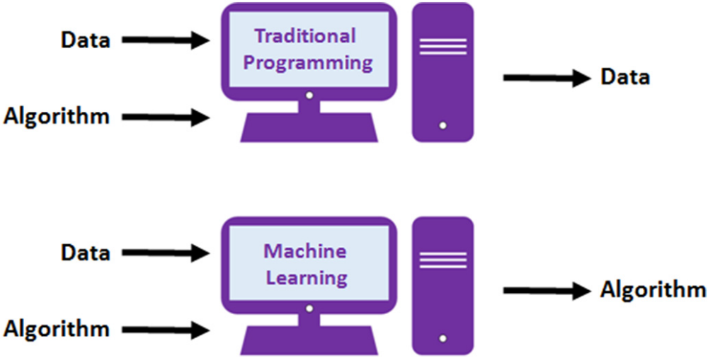
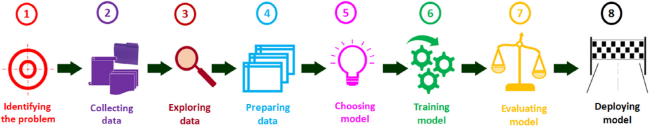
Thanks to machine learning, models can be generated that can predict the properties of materials long before they are synthesized.
Notes:
Primena mašinskog učenja u razvoju novih polimera je takođe uzela maha. Naravno, kako bi se primenili metodi mašinskog učenja i generisali modeli kojima se mogu predviđati svojstva novih ili modifikovanih polimera, neophodno je imati dovoljno velike i dovoljno dobre skupove podataka.
In traditional programming, a computer follows a set of predefined rules to process input data and generate output.
For example, you might write a program that uses a specific algorithm to calculate the molecular weight of a compound from its chemical formula.
In contrast, machine learning takes a different approach. Imagine you want to predict the solubility of a new chemical compound. Instead of programming explicit rules, you would train an algorithm (such as a decision tree or neural network) on a dataset containing information about the chemical structures and solubility of existing compounds.
The algorithm would then learn to identify patterns and relationships within the data, allowing it to predict the solubility of new compounds without direct instructions.
This approach, which is gaining traction in the field of chemistry, holds the promise of highly accurate predictions of chemical properties, reaction outcomes, and material behaviors. It often reduces the need for extensive experimental testing, offering a more efficient and cost-effective solution.

Slide 25
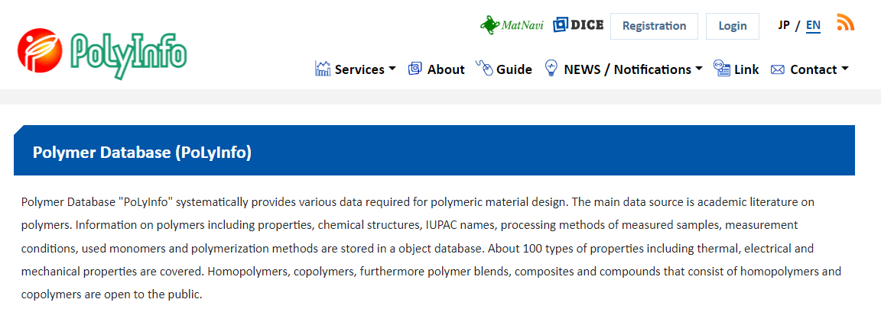
Polymer datasets
https://polymer.nims.go.jp/
Notes:
Primena mašinskog učenja u razvoju novih polimera je takođe uzela maha. Naravno, kako bi se primenili metodi mašinskog učenja i generisali modeli kojima se mogu predviđati svojstva novih ili modifikovanih polimera, neophodno je imati dovoljno velike i dovoljno dobre skupove podataka gde su data svojstva polimera utvrđena eksperimentalno, ili primenom pouzdanih teorijskih metoda.
U vezi sa polimerima, važno je napomenuti nekoliko reprezentativnih izvora gde se mogu pronaći i skinuti podaci kako bi se nad njima generisali i testirali novi modeli.
Naime, da bi se primenili metodi mašinskog učenja moramo imati dovoljan broj struktura polimera kako bismo sproveli naše proračune nad tim strukturama, generišemo modele za predviđanje svojstava na osnovu naših proračuna i mogli da uporedimo rezultate sa eksperimentalnim vrednostima.
U narednih nekoliko slajdova predstaviću neke besplatno dostupne baze podataka koje sadrže informacije o strukturama polimera i vrednostima nekih specifičnih veličina dobijenih eksperimentalnim putem.
Za početak, tu je baza PolyInfo, koja sadrži podatke o polimerima preuzete iz naučne literature. Između ostalih podataka, sadrži IUPAC nazive polimera, uslove pod kojima su merene vrednosti, preko 100 tipova svojstava, uključujući termalna, električna i mehanička svojstva.
Za upotrebu baze je neophodna registracija i posebno odobrenje za pretraživanje i preuzimanje podataka, što je u potpunosti razumljivo, imajući u vidu koliko je vremena i resursa neophodno da bi se jedna takva baza napravila i održavala.

Slide 26
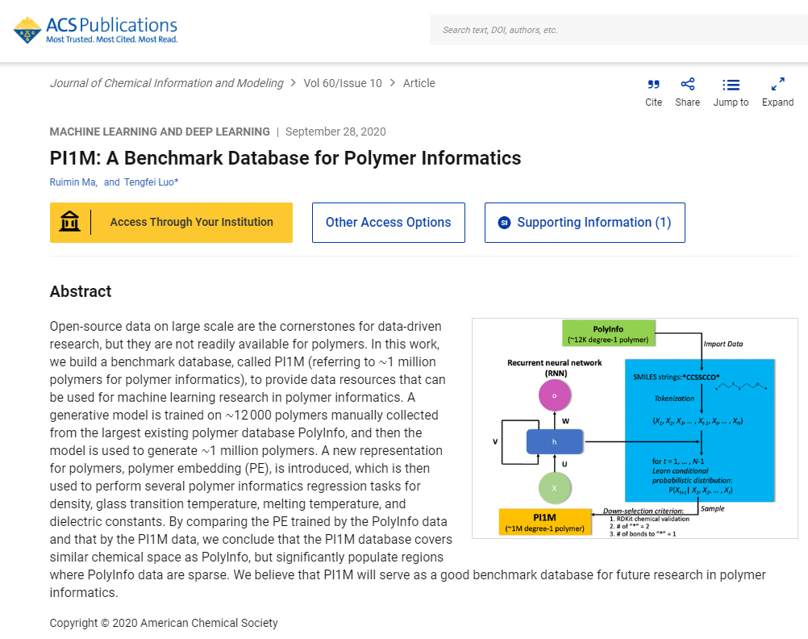
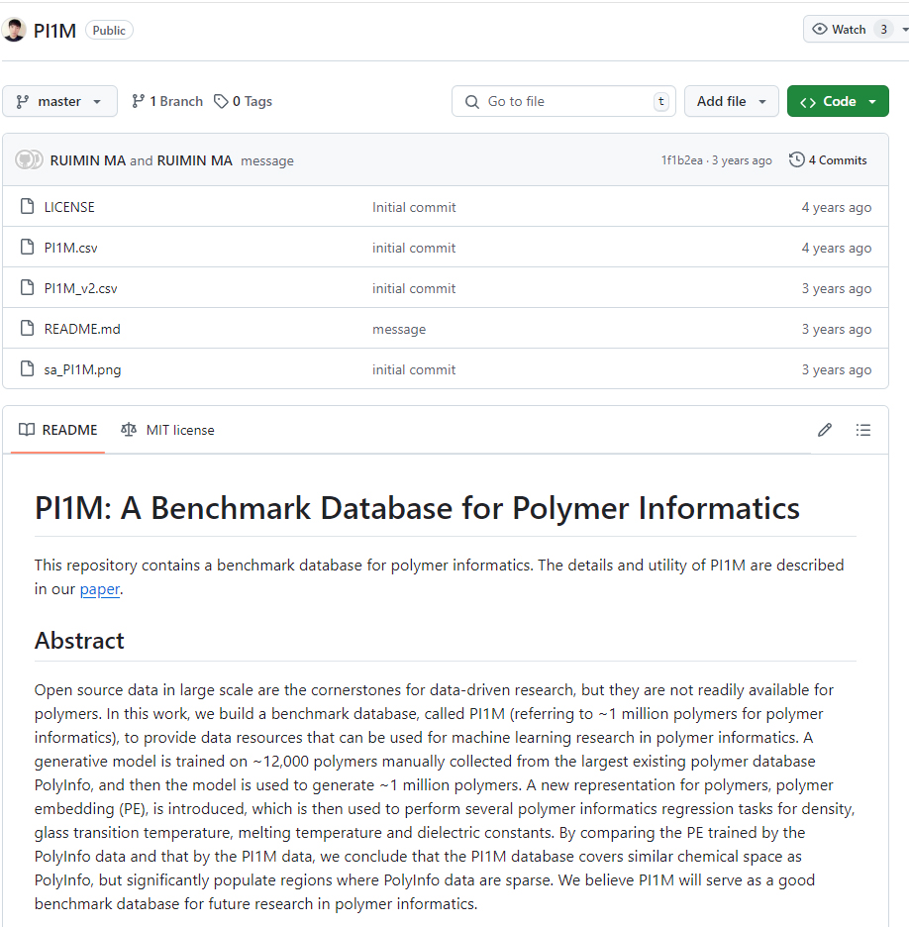

Polymer datasets
Notes:
Sledeća baza podataka je posebno zanimljiva, jer sadrži strukture skoro million polimera, koje su generisane primenom mašinskog učenja na oko 12000 polimera iz prethodno predstavljene baze, PolyInfo.
Pored struktura polimera u SMILES formatu, autori su metodama mašinskog učenja za svaku strukturu dali i ocenu koja označava koliko je lako/teško sintetisati svako od tih jedinjenja. Taj parameter se naziva “Sintetička dostupnost (SA)” i izračunata je korišćenjem Schuffenhauer-ove SA ocene (https://jcheminf.biomedcentral.com/articles/10.1186/1758-2946-1-8). To je zapravo heuristička procena o tome koliko je teško (10) ili lako (1) sintetisati određen molekul. SA ocena je dodata u fajl sa strukturama generisanih polimera, a sav materijal se može preuzeti sa GitHub servisa. Neophodno je biti registrovani član GitHub-a.

Slide 27
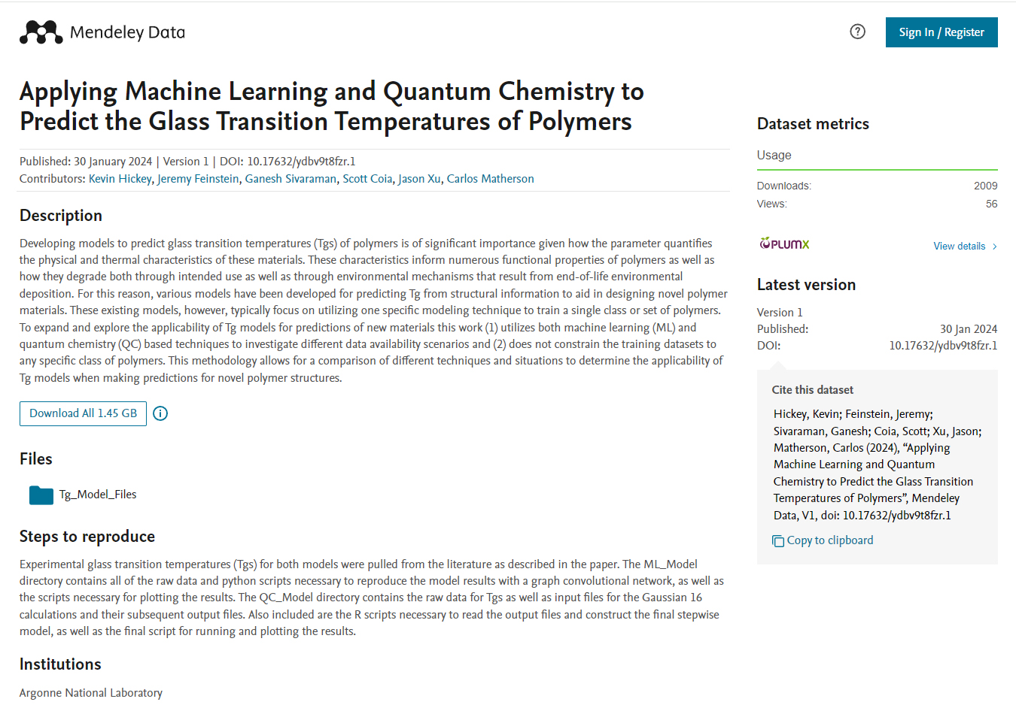
Polymer datasets
Notes:
Sledeća baza podataka sa informacijama o polimerima je jako bitna za one istraživače kojima je temperatura staklastog prelaza polimera od interesa.
Temperatura staklastog prelaza (Tg) je temperatura pri kojoj se polimer prelazi iz staklastog, krutog stanja u mekše, gumasto stanje. Ispod ove temperature, polimeri su kruti i lomljivi, dok iznad nje postaju elastičniji i fleksibilniji. Tg je važna osobina polimera jer utiče na njihove mehaničke osobine i primene. Na primer, polimeri sa višom temperaturom staklastog prelaza će biti stabilniji i zadržavati svoju čvrstinu na višim temperaturama.
Ova baza podataka sadrži modele i sirove podatke za predviđanje temperature staklastog prelaza (Tg) polimera koristeći tehnike mašinskog učenja (ML) i kvantne hemije (QC). Uključuje Python skripte za rezultate ML modela, ulazne i izlazne fajlove iz programa Gaussian 16 za QC modele, kao i R skripte za obradu i vizualizaciju podataka.
Jednostavnije rečeno, ova baza podataka sadrži strukture polimera i eksperimentalno određene temperature staklastog prelaza (Tg) za svaki polimer. To omogućava korisnicima da koriste ove podatke za izradu sopstvenih modela predikcije Tg pomoću različitih tehnika, uključujući mašinsko učenje i kvantnu hemiju.

Slide 28
Machine learning – Practical example
Row # | SMILES structure | H-L gap [eV] | Max MEP [kcal/mol] | Min ALIE [kcal/mol] | TSA [Å²] | Tg [ºC]
1. | C=Cc1ccccc1, | 5.339 | 16.47 | 200.15 | 288.676 | 367.0879
2. | C=C(C)C(=O)OC | 6.208 | 17.00 | 209.40 | 279.319 | 375.8394
3. | O=C1CCCCCO1 | 6.033 | 21.83 | 228.93 | 281.915 | 253.5962
. | . | . | . | . | . | .
. | . | . | . | . | . | .
. | . | . | . | . | . | .
7558. | *CC(*)(F)C(=O)OCC(Cl)(Cl)Cl | 7.423 | 22.73 | 237.22 | 366.527 | 127.0050
Taken from reference*
Performed calculations
Taken from reference*
* Computational Materials Science, 238 (2024) 112933
Notes:
Glass Transition Temperature
SMILES structures are used to encode molecules in a way that can be easily read by computers for input into databases and computational chemistry software.
SMILES structure for water (H₂O) is represented as "O", and for ethanol (C₂H₅OH), it's "CCO"

Slide 29
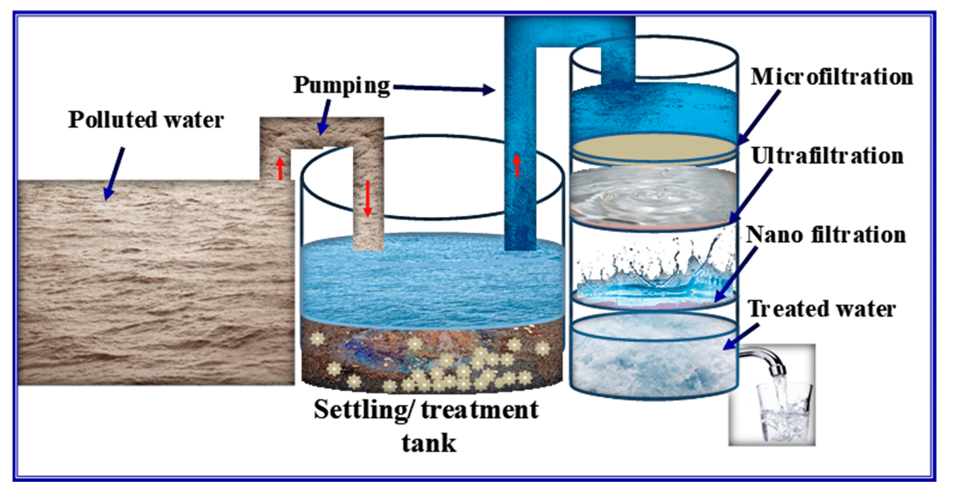
Exploring the role of polymers in water purification is essential for several reasons:
Wide application
Polymers can be modified for specific water treatment needs, enhancing filtration, adsorption, and catalysis processes for more effective solutions.
Progress
Combining polymers with modeling and machine learning improves the efficiency of purification systems by optimizing polymer types and conditions.
Sustainability
Polymers can be designed to be more sustainable and cost-effective, offering environmentally friendly water treatment options.
Emerging Contaminants
Polymers can be customized to target new and evolving contaminants, providing adaptable solutions for water quality challenges.
Polymers 2023, 15(16), 3421
Integration
Understanding polymers enables their integration with existing technologies, enhancing traditional methods and developing improved hybrid solutions.

Slide 30
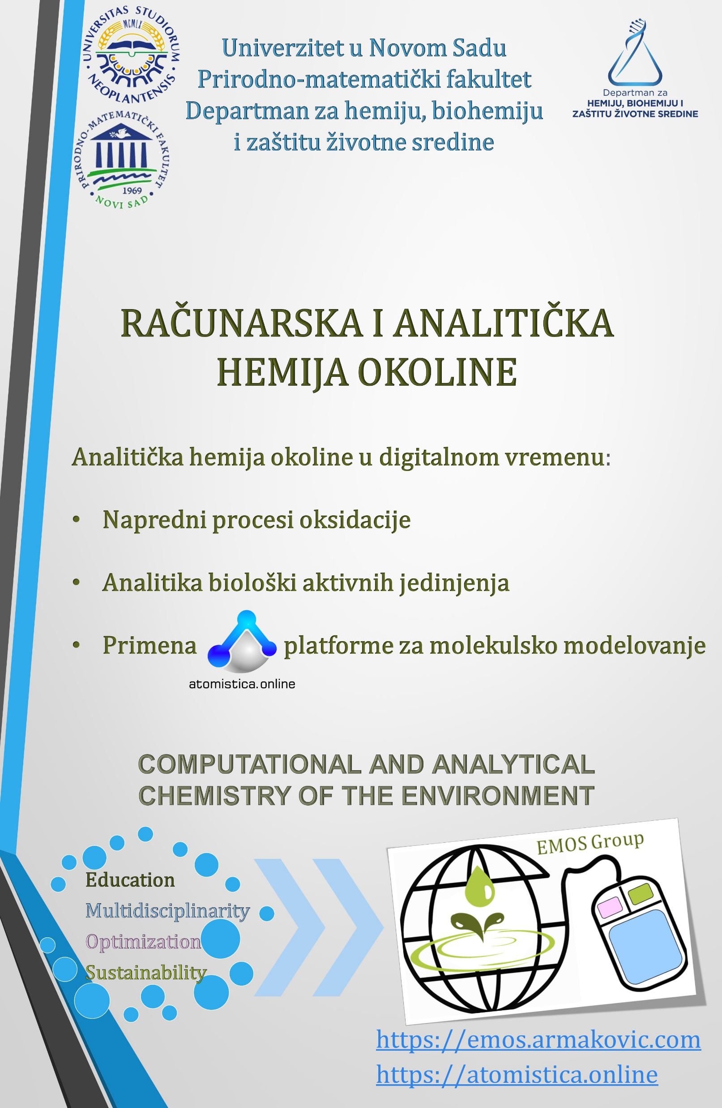

Members of the research group for
COMPUTATIONAL AND ANALYTICAL ENVIRONMENTAL CHEMISTRY

Slide 31
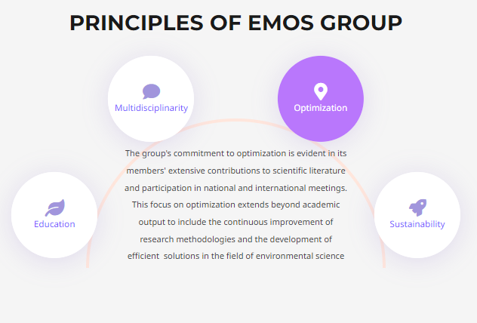
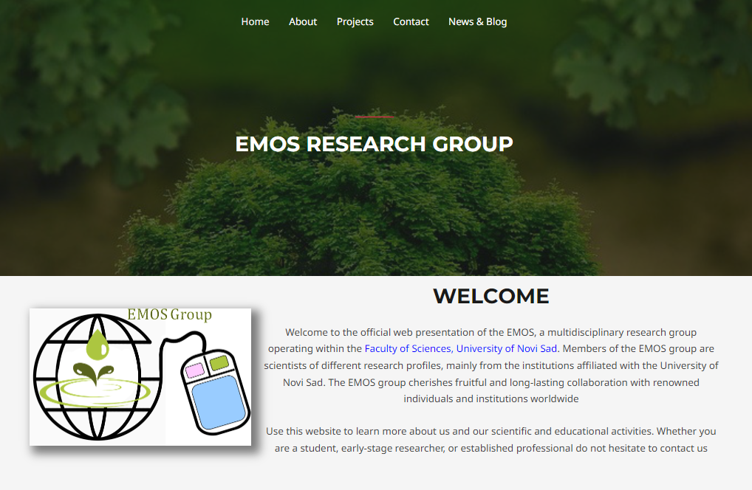
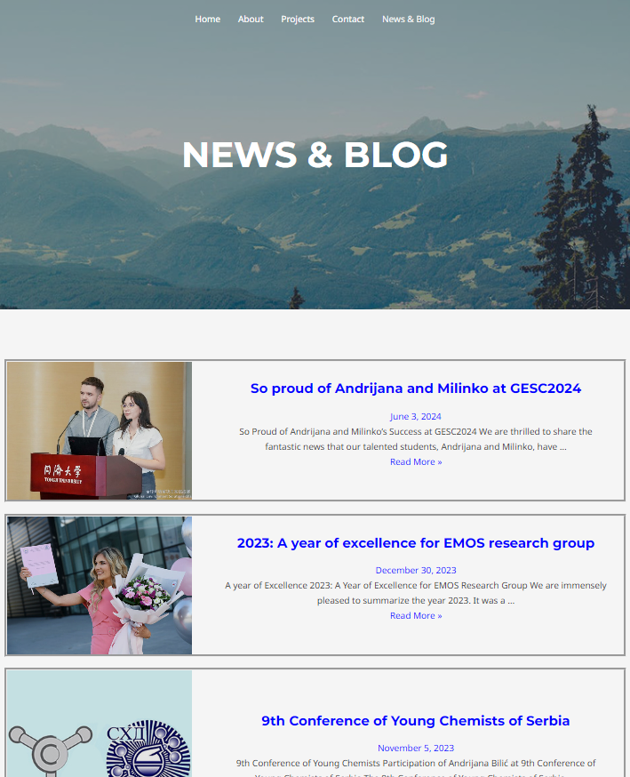
https://emos.armakovic.com/

Slide 32
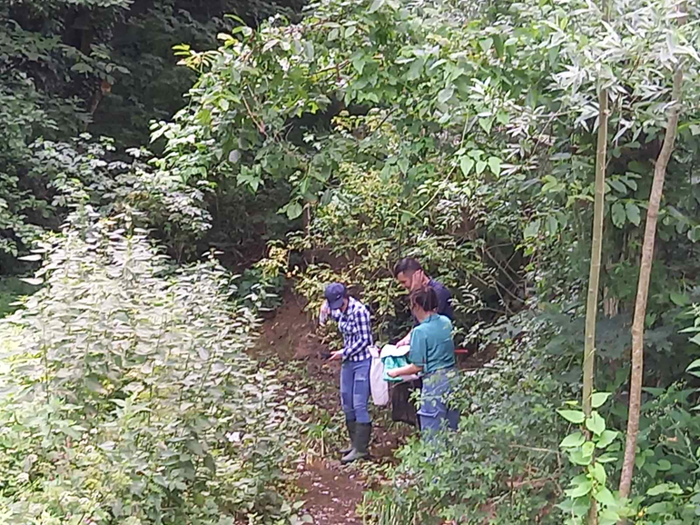
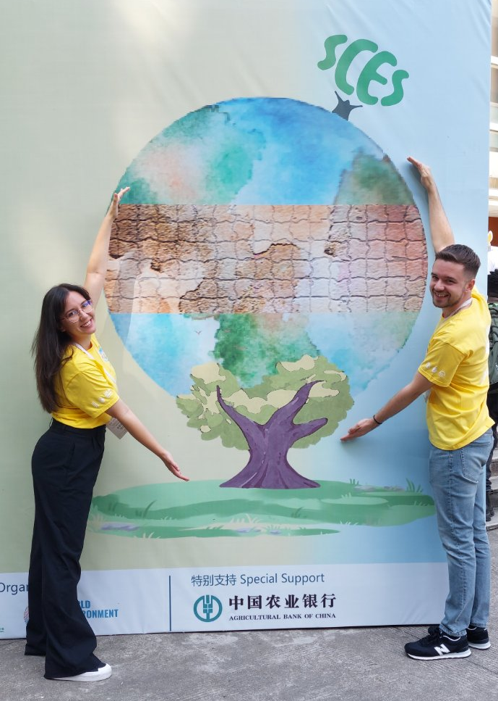

Slide 33
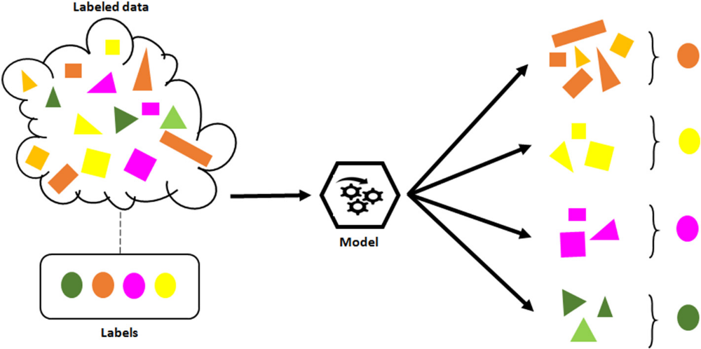
Machine learning techniques
Supervised learning
In supervised machine learning, algorithms apply what they have learned from labeled data to make predictions on new, unseen data. In other words, supervised machine learning methods are ideal for tasks where the goal is to predict or classify specific outcomes based on existing examples. A well-known example of supervised learning is the use of applications that predict how a person's face might look as they age.
A common example of supervised machine learning in chemistry is predicting the toxicity of chemical compounds. By training an algorithm on a dataset of known compounds with labeled toxicity levels, the model can learn the relationship between a compound's molecular structure and its toxicity. Once trained, the algorithm can then predict the toxicity of new, untested compounds, helping researchers identify potentially hazardous chemicals without the need for extensive laboratory testing.

Slide 34
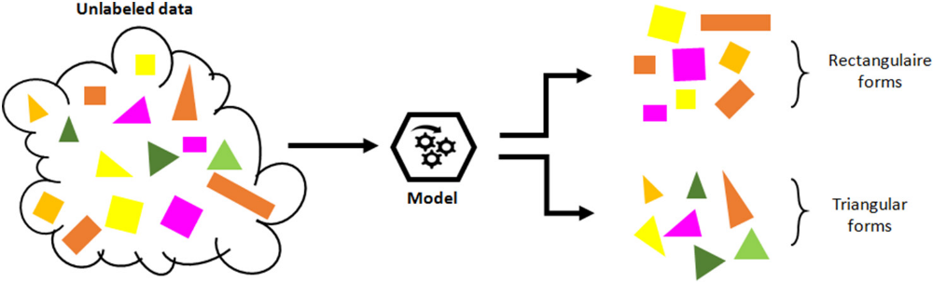
Machine learning techniques
Unsupervised learning
The model independently explores and identifies patterns and insights that were not previously known. For instance, an unsupervised model may initially group data based on geometric shapes. If the results are not satisfactory, the model can be retrained to detect different patterns, such as grouping by surface texture or color instead.
The model might be trained on data from various water quality monitoring stations that include measurements of different pollutants in water. Initially, the model might cluster the data based on patterns in pollutant levels.
If the initial clustering based on pollutant types doesn’t yield clear results, the model can be retrained to identify different patterns, such as clustering by geographic regions or time of year. This could reveal, for example, that certain pollutants are more prevalent in specific areas or at particular times, helping researchers understand pollution sources and trends without predefined categories.
By identifying these patterns, the model helps in creating targeted strategies for pollution control and environmental management.

Slide 35
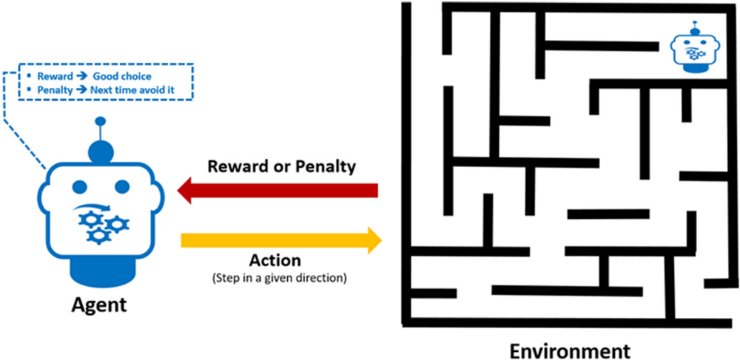
Machine learning techniques
Reinforcement Learning
In RL, the learning system, known as the agent, explores its environment through a series of actions.
When the agent takes a positive action, it receives a reward (positive feedback), and when it takes a negative action, it incurs a penalty (negative feedback).
By seeking to maximize rewards and avoid penalties, the agent gradually learns the best strategy to navigate its environment.
In other words, this method enables the agent to make a series of decisions to achieve the highest possible score, all without human intervention or explicit programming for the specific task.

Slide 36
Machine learning techniques
Reinforcement Learning
Imagine an agent tasked with optimizing a water treatment process to remove contaminants. Each time the agent makes an adjustment to the treatment parameters (e.g., pH levels, chemical dosages), it receives feedback. If the adjustment leads to improves water quality (e.g., better removal of pollutants), the agent earns a reward (positive feedback). If the adjustment worsens water quality, the agent incurs a penalty (negative feedback).
By continuously seeking to maximize rewards and minimize penalties, the agent gradually learns the best strategy to optimize the water treatment process. This approach allows the agent to autonomously develop an effective treatment protocol without explicit instructions or human intervention.
For example, imagine an agent navigating through different combinations of treatment steps in a simulated water treatment plant. Each step either improves or degrades water quality. Over time, the agent learns the optimal sequence and settings to achieve the highest water purity, effectively finding the best treatment strategy on its own.

